Slide 1
Car dealer analysis

Slide 2
The data
The dataset contains data on cars auction sales in USA over 2014-2015
The table contains about 500,000 sales with various information on the selling cars like: year of production, manufacture, model, body kind, milage, selling price, MMR price(cars valuation company) ETC.

Slide 3
My research question
As a private car dealer ,which car I should buy and sell in my business ?
Looking for answers to focus the dealer on which deals he should look for.
Let’s explore into the analysis:

Slide 4
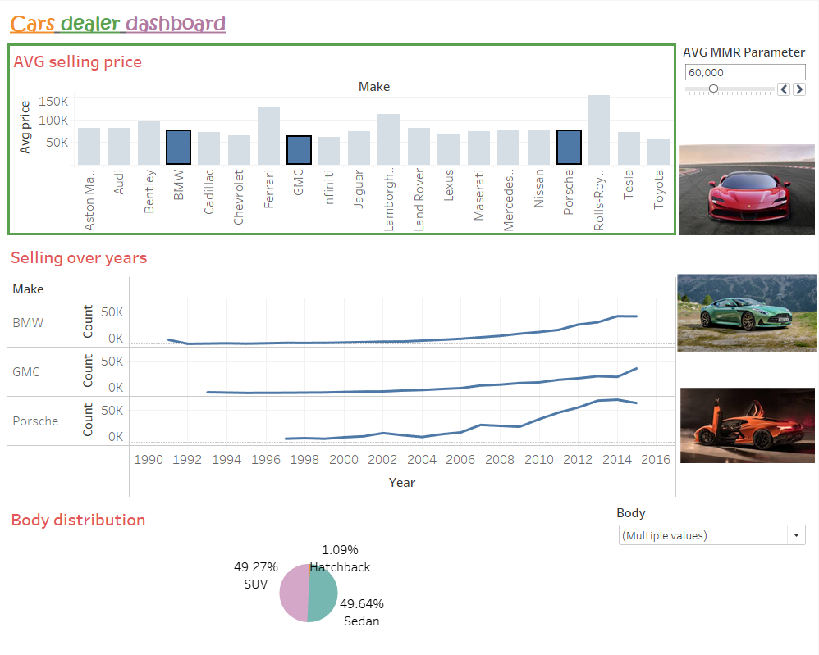
Tableau Dashboard

Slide 5
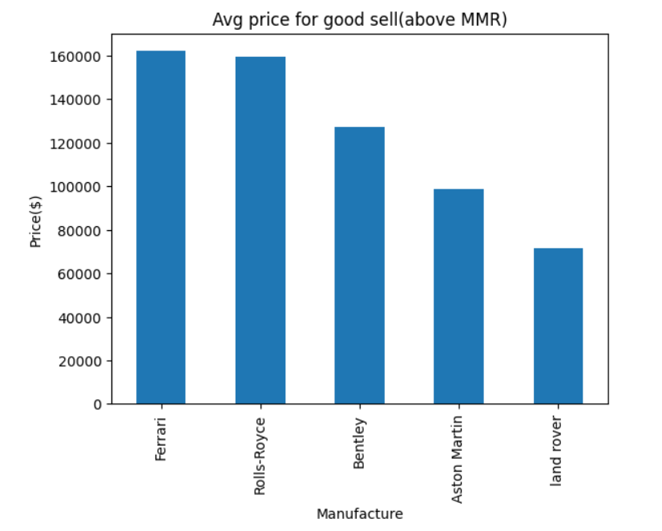
Quality Vs. Quantity
Quality
I wanted to check which manufacture
had the highest avg selling price for good sales- sales that the selling price was over the MMR price.

Slide 6
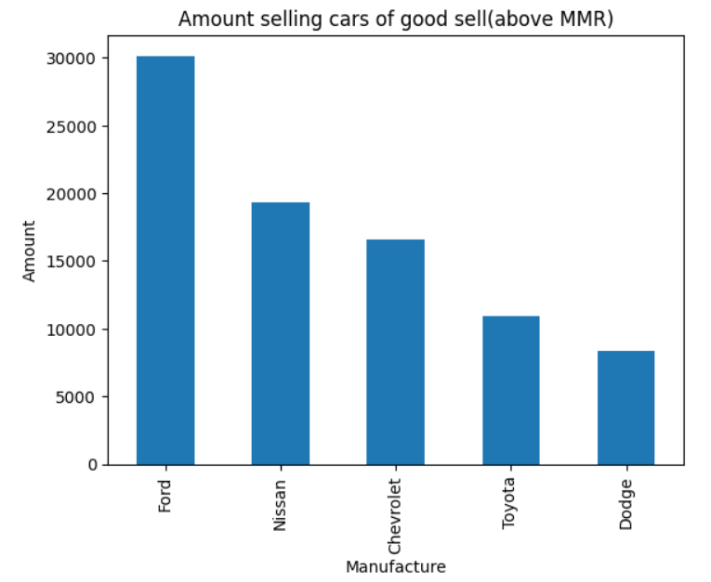
Quantity
I wanted to check which manufacture had the biggest amount for good sales- sales that the selling price was over the MMR price.

Slide 7
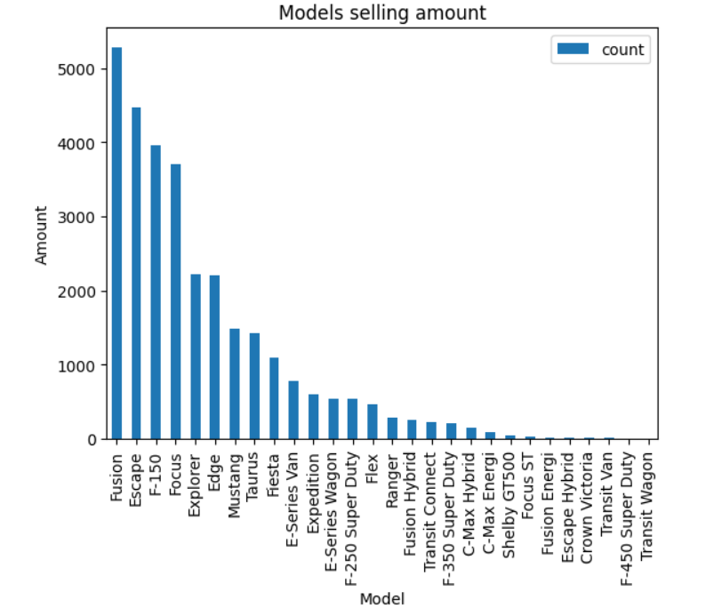
We can see that the highest amount of car sales is Ford company, so I wanted to check which model is best to buy according to the amount of model selling.

Slide 8
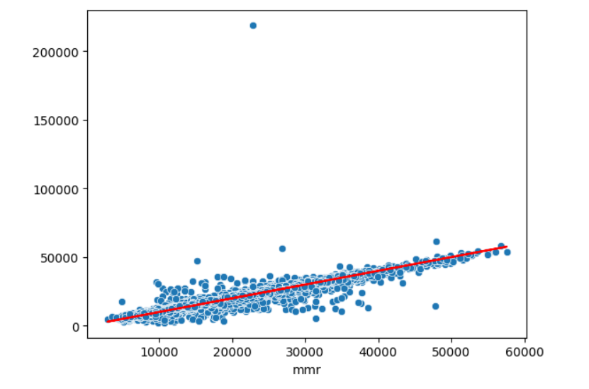
Another aspect that we want to check is that if the mmr prices valuation can be reliable source to trust when buying/selling cars:
correlation between the MMR price and the selling price(linear regression)

Slide 9
Conclusion and insights
We can see with the dashboard a highlight on specific manufacture that is relevant for the dealer’s budget with data over the years.
We can see quality vs. quantity aspects for the dealer to look for different deals.
We had a specific example for “best quantity sales” for a dealer to look for deals, that he will be part of this hot market.
We can insight that the MMR car valuation price is good for use and the price the dealer will buy/sell, is recommended to be according it.

Slide 10
Questions?

